Slide 1


UNIT 4: Clocks and calendars
Unit 4 – Roundup & Writing rules 4

Slide 2
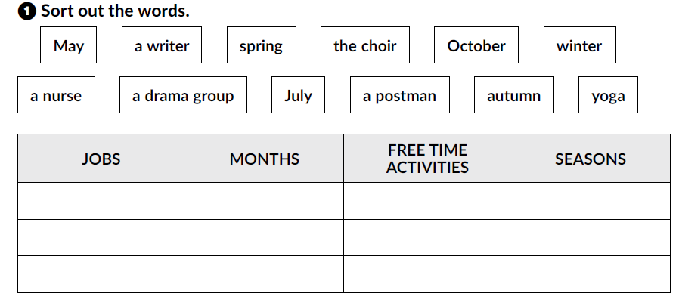
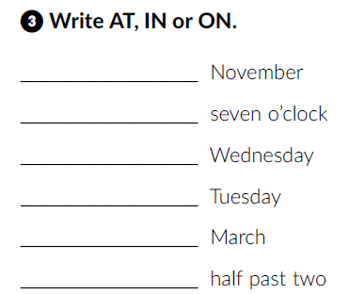
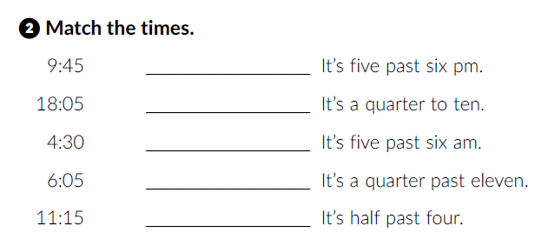
Workbook, p. 54 and 55.
a writer
May
the choir
spring
a nurse
October
a drama group
winter
a postman
July
a writer
autumn
in
18:05
at
9:45
on
6:05
on
11:15
in
4:30
at

Slide 3
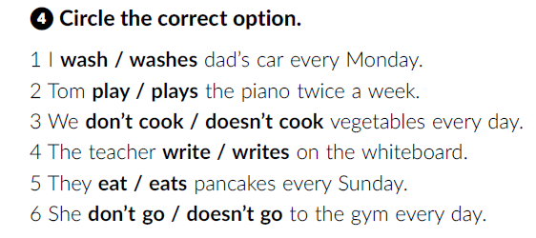
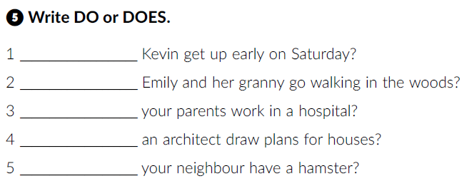
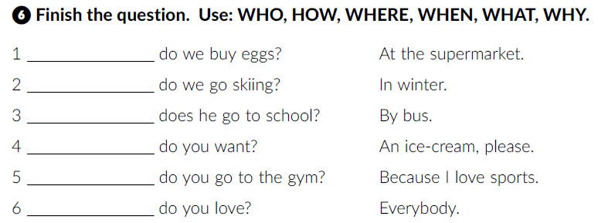
Does
Do
Do
Does
Does
Where
When
How
What
Why
Who

Slide 4
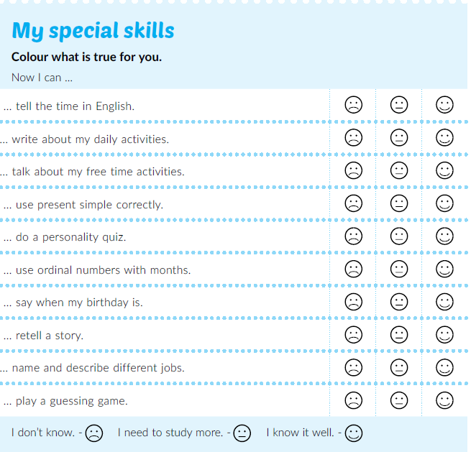

Textbook, p. 79
Read Dario’s learning tips.

Slide 5
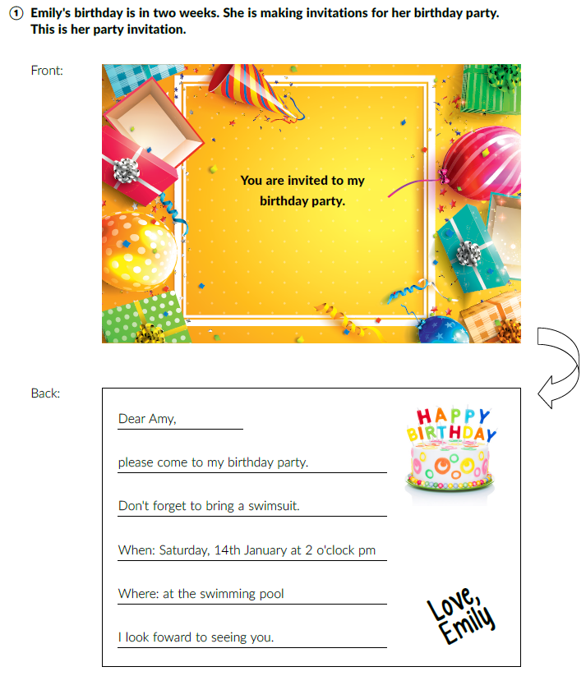
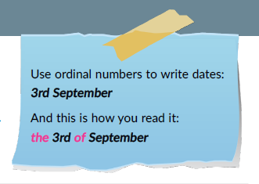
Textbook, pages 77-78.
Read the birthday invitation.
Whose birthday party is it?
Who is invited?
What should Amy bring to the party?
Where does the party take place?
When is it?
When is your birthday?
Where do you usually have your birthday party?
How many children do you usually invite?
Do you invite the whole class?
Do you make birthday invitations?

Slide 6
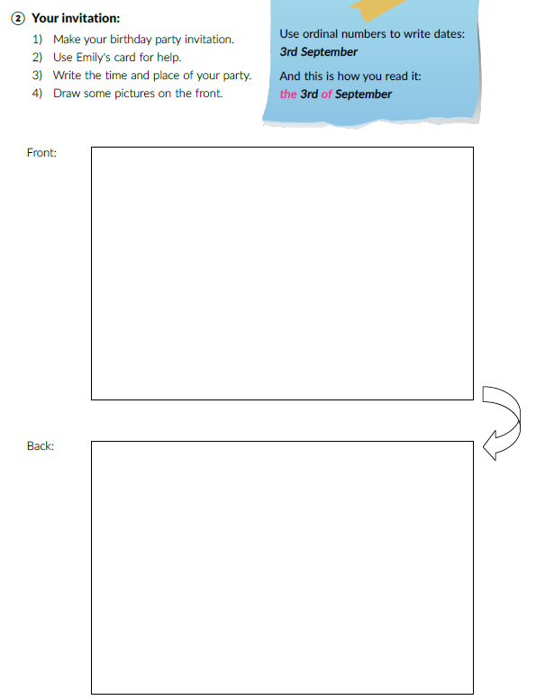

Read the instructions and write your invitation.

